Slide 1

Aws Cloud Virtual Internship
by
P.HARSHITHA
Roll No. 214G1A3223
Department of Computer Science and Engineering (Data Science)
Srinivasa Ramanujan Institute of Technology
(Affiliated to JNTUA & Approved by AICTE) (Accredited by NAAC with ‘A’ Grade & Accredited by NBA (EEE, ECE & CSE)
Rotarypuram Village, B K Samudram Mandal, Ananthapuramu – 515701.
2024 - 2025

Slide 2
Contents
Course Objective
Introduction
Types
Advantages
Applications
Outcomes
conclusion
GitHub Link
Queries

Slide 3
Course Objective
Understand Cloud Concepts: Learn the basics of cloud computing and AWS services.
Different types of cloud computing models.
Understand Different Aws Cloud Concepts.
Selecting a Service based on Requirements.
Basics of networking.
Throughout the internship, participants will gain hands-on experience in Technical Skills Development to enhance skills in cloud computing technologies, including services like virtual machines, databases, and storage solutions.

Slide 4
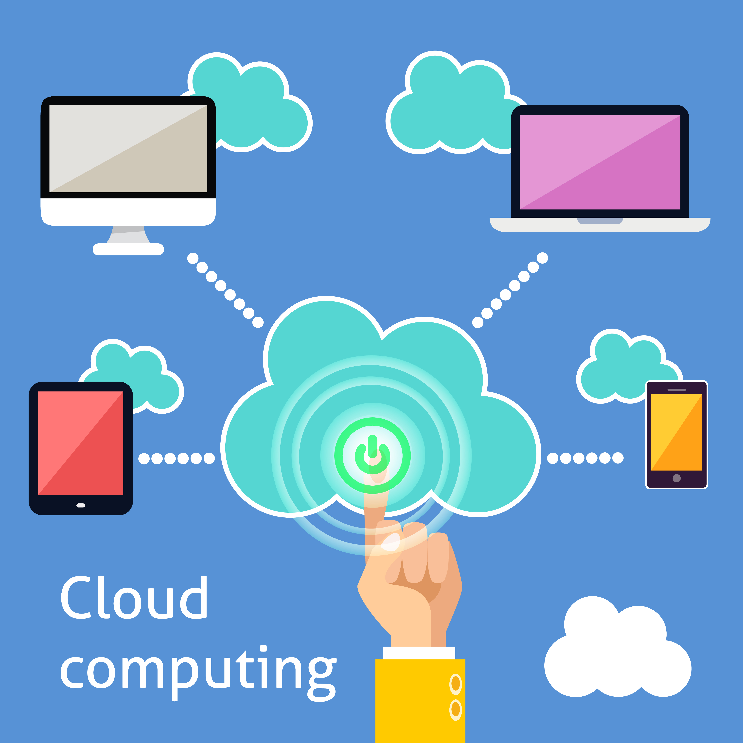
INTRODUCTION
What is Cloud Computing?
Cloud computing is the on-demand
delivery of compute power, database,
storage, applications, and other IT
resources via the internet with
pay-as-you-go pricing.
so on. When

Slide 5
INTRODUCTION
What is Aws?
Aws is a cloud-based platform for building business solutions using interconnected web services.
Provides a variety of pre-built services to help businesses create custom cloud-based solutions.
Trusted by both small and large firms due to its comprehensive features. Supports a wide range of workloads, including:
Game development
Data processing
Data warehousing
Archiving
Software development

Slide 6
TYPES OF CLOUD COMPUTING
1. Infrastructure as a Service (IaaS):
IaaS contains the basic building blocks for cloud IT. It typically provides access to networking features, computers (virtual or on dedicated hardware), and data storage space. IaaS gives you the highest level of flexibility and management control over your IT resources. It is most similar to the existing IT resources with which many IT departments and developers are familiar.
2. Platform as a Service (PaaS):
PaaS removes the need for you to manage underlying infrastructure (usually hardware and operating systems), and allows you to focus on the deployment and management of your applications. This helps you be more efficient as you don’t need to worry about resource procurement, capacity planning, software maintenance, patching, or any of the other undifferentiated heavy lifting involved in running your application.

Slide 7
TYPES OF CLOUD COMPUTING
3. Software as a Service (SaaS):
SaaS provides you with a complete product that is run and managed by the service provider. In most cases, people referring to SaaS are referring to end-user applications (such as web-based email). With a SaaS offering, you don’t have to think about how the service is maintained or how the underlying infrastructure is managed.

Slide 8
Advantages of cloud computing
Advantages of cloud computing:
Trade capital expense for variable expense:
Capital expenses (capex) are funds that a company uses to acquire, upgrade, and maintain physical assets such as property, industrial buildings, or equipment.
User-friendly
Stop spending money on running and maintaining data centers.
Go global in minutes:
You can deploy your application in multiple AWS Regions around the world with just a few clicks. As a result, you can provide a lower latency and better experience for your customers simply and at minimal cost.

Slide 9
why companies need AWS
1.Easy to use: AWS is designed to allow application providers, ISVs, and vendors to quickly and securely host your applications – whether an existing application or a new SaaS-based application.
2.Flexible: AWS enables you to select the operating system, programming language, web application platform, database, and other services you need.
3.Cost-Effective: You pay only for the compute power, storage, and other resources you use, with no long-term contracts or up-front commitments.
4.Reliable: With AWS, you take advantage of a scalable, reliable, and secure global computing infrastructure, the virtual backbone of Amazon.
5.Scalable and high-performance: Using AWS tools, Auto Scaling, and Elastic Load Balancing, your application can scale up or down based on demand.
6.Secure: AWS utilizes an end-to-end approach to secure and harden our infrastructure, including physical, operational, and software measures.

Slide 10
How Does Aws Works?
It offers cloud capability by using its data centres established in all the concerned locations and works via a fibre network.
Amazon web services, being a widely adopted cloud platform can be used for any cloud work.
The Same AWS can be used in all industries for their cloud needs. Small-sized, medium businesses, and large enterprises can easily use AWS to experiment, innovate faster, lower costs, and become more agile in terms of efficiency and development.
Suppose you work on your own eCommerce store, and you are responsible for all data changes such as updates and security patches, scaling, backups, failovers, and more.
All you need to do that manually. But you can use Amazon Relational Database Service (Amazon RDS). Just in a few clicks, you can run the relational Database of your choice.

Slide 11
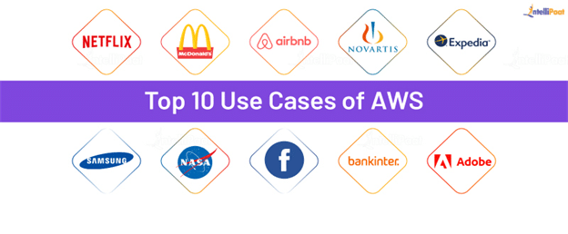
Example of AWS
Netflix is an entertainment platform that
startedNetflix
in the United States, but eventually, it expanded to
many countries and soon became popular.
However, once Netflix confronted the scalability
problem because of the sudden increase in
viewers. That made Netflix choose AWS services.
Netflix reports that when it started using AWS
services like DynamoDB and Cassandra for its
distributed databases, it could handle the data easily.

Slide 12
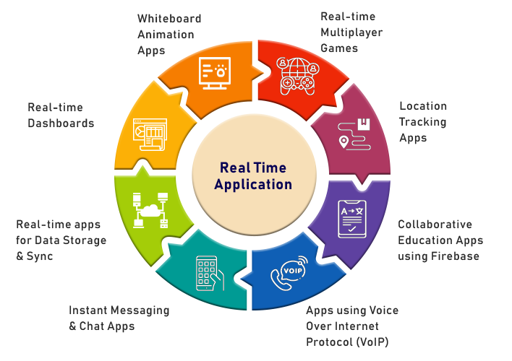
REAL TIME APPLICATIONS
•Storage and Backup
•﻿Big Data
•﻿Enterprise IT
•﻿Social Networking
•﻿Mobile Apps
•﻿Websites
•Gaming

Slide 13
REAL TIME APPLICATIONS
Storage and Backup:
Storage and backup are important for any Cloud Computing service. AWS provides you with reliable storage services like Amazon Simple Storage Service to store large-scale data and backup services like AWS Backup to take backups of this data, which is stored in other AWS services.
﻿Big Data:
One of the biggest challenges faced by companies these days is Big Data. The companies are struggling to store their large amounts of data using traditional methods.
﻿Mobile Apps:
Mobile applications are embedded with day-to-day life. With AWS, you have the facility to create an app in your desired programming language.
﻿Websites:
AWS offers a wide range of website hosting options to create the best website for customers.
Gaming:
AWS has been serving many gaming studios. Combining Amazon EC2 and S3 services.

Slide 14
Learning Outcomes
Aws is a cloud-based platform for building business solutions using interconnected web services.
Understanding Cloud Computing Concepts: Gain a solid understanding of cloud computing, including key concepts such as on-demand resource provisioning, scalability, and cost management.
Proficiency in AWS Services: Learn to deploy and manage virtual servers (EC2), serverless functions (Lambda), and containerized applications (ECS, EKS).
Skills in Designing Cloud Architectures: Learn to design scalable, high-availability, and fault-tolerant architectures using AWS services.
Hands-On Experience with AWS Tools: Become proficient in using AWS Management Console, CLI, and SDKs for managing resources.
Problem-Solving Skills
Integration with Other Technologies

Slide 15
Conclusion
In conclusion, AWS is one of the most effective and path-breaking Cloud services.
It has given a competitive edge to cloud computing technology by making it feasible and accessible to the entire world with minimum cost and world-class support.
AWS has slowly become a preferred necessity for IT industries looking to host their data on the cloud.
The platform’s emphasis on security and compliance helps businesses protect their data and meet regulatory requirements.
Overall, AWS Cloud is an essential resource for businesses seeking to leverage cloud technology to enhance their operations, drive growth, and stay competitive in the digital age.

Slide 16
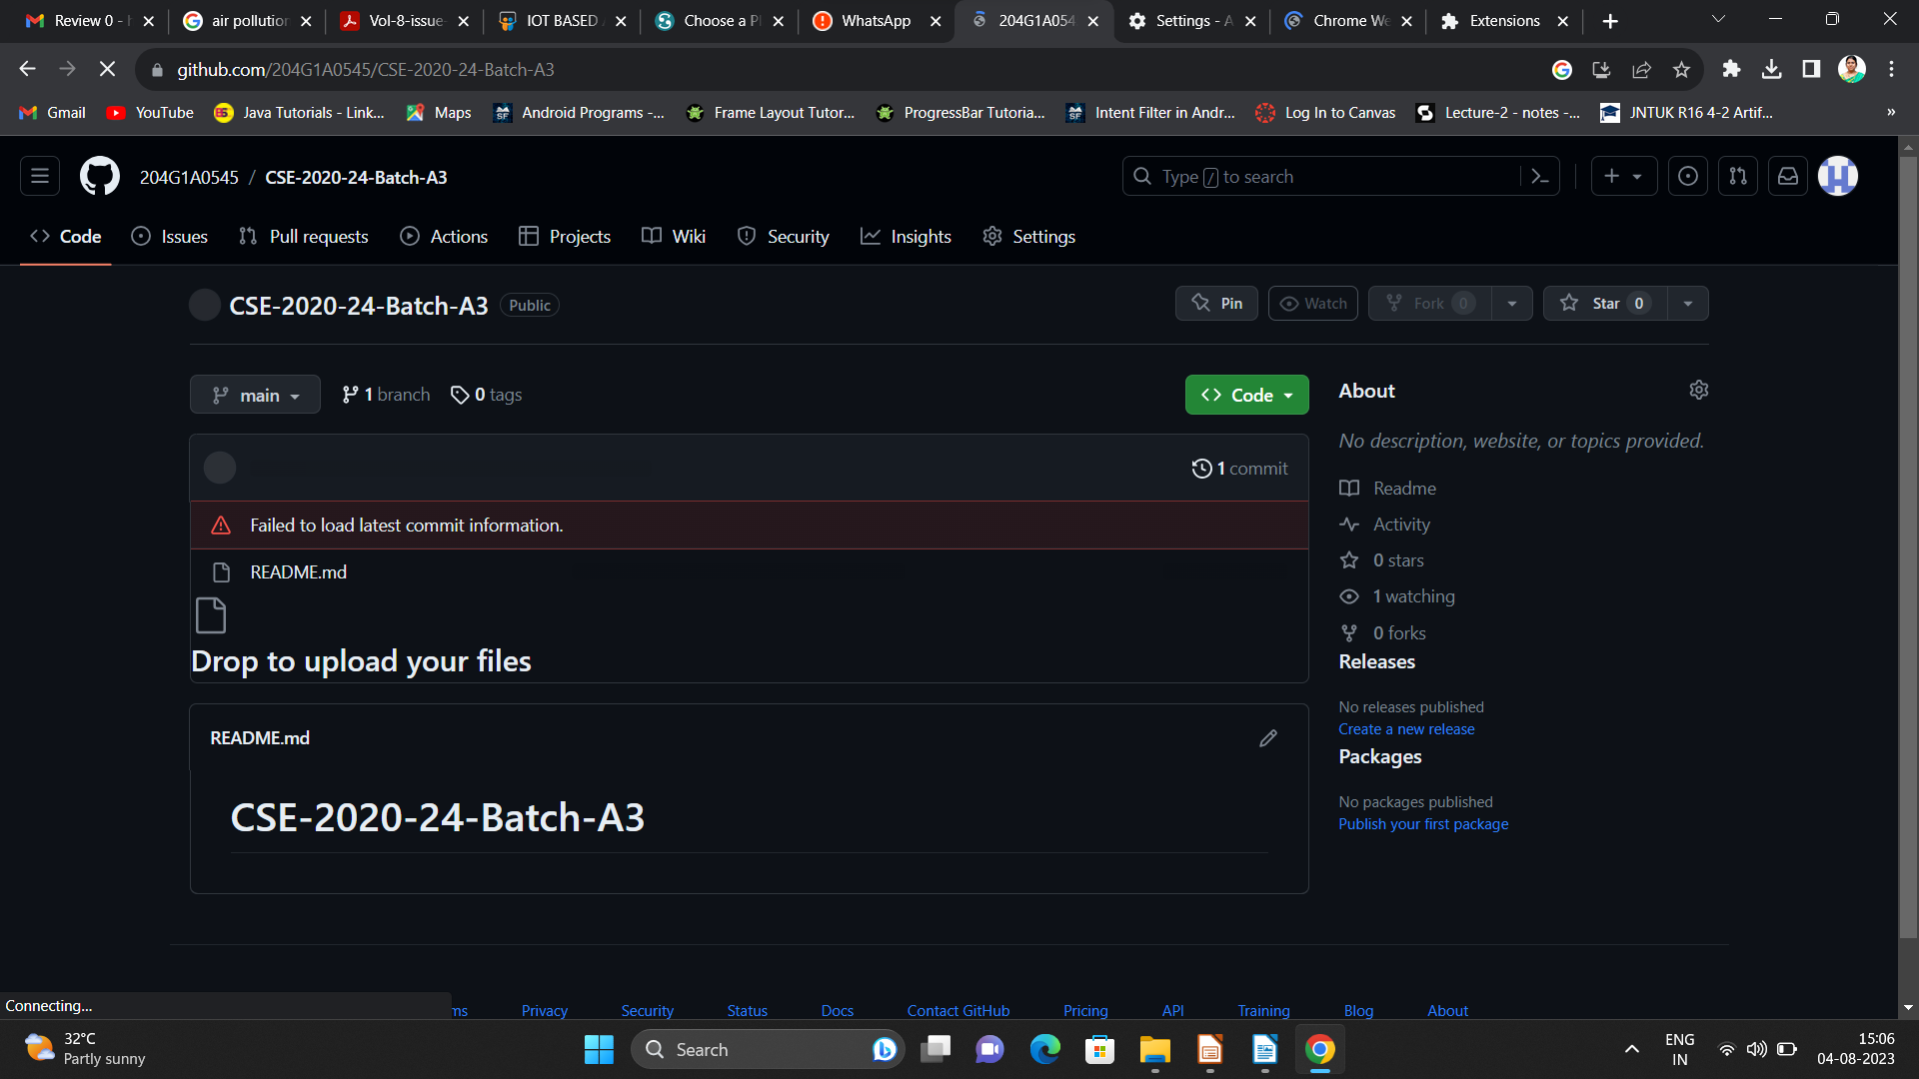

Git Hub Dashboard
Repository Name Like: Summer Internship - I
Under that include document, presentation and Certificate(Pdf).

Slide 17
Any Queries?

Slide 18
Thank You!!!

